Slide 1
Arise Above The Storm…
Know your storm…
See Jesus in your storm…
7 Lessons to survive the storm…

Slide 2
Matius 14:22-27 Yesus berjalan di atas air 14:22 Sesudah itu Yesus segera memerintahkan murid-murid-Nya naik ke perahu dan mendahului-Nya ke seberang, sementara itu Ia menyuruh orang banyak pulang. 14:23 Dan setelah orang banyak itu disuruh-Nya pulang, Yesus naik ke atas bukit untuk berdoa seorang diri. Ketika hari sudah malam, Ia sendirian di situ. 14:24 Perahu murid-murid-Nya sudah beberapa mil jauhnya dari pantai dan diombang-ambingkan gelombang, karena angin sakal. 14:25 Kira-kira jam tiga malam datanglah Yesus kepada mereka berjalan di atas air. 14:26 Ketika murid-murid-Nya melihat Dia berjalan di atas air, mereka terkejut dan berseru: "Itu hantu! ", lalu berteriak-teriak karena takut. 14:27 Tetapi segera Yesus berkata kepada mereka: "Tenanglah! Aku ini, jangan takut!"

Slide 3
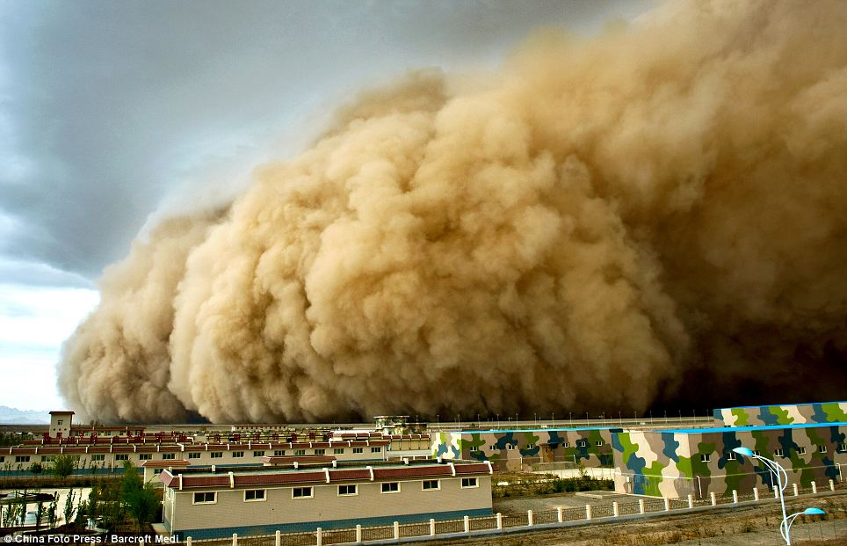
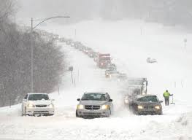
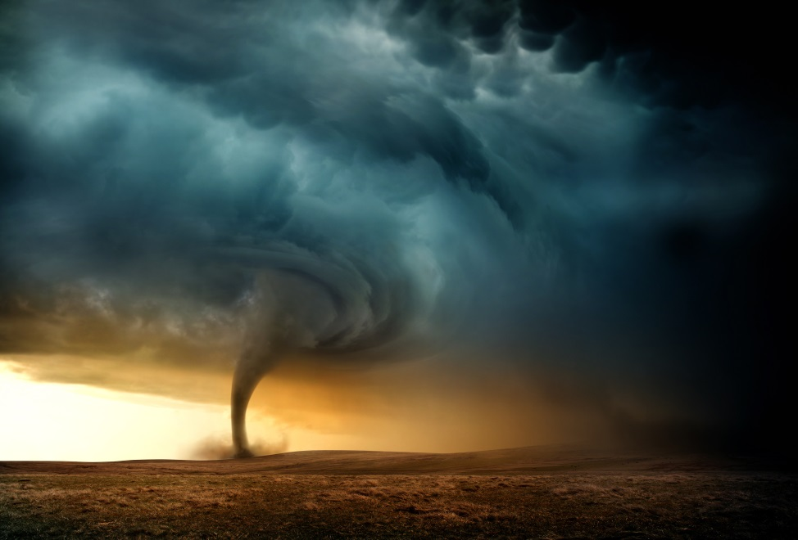
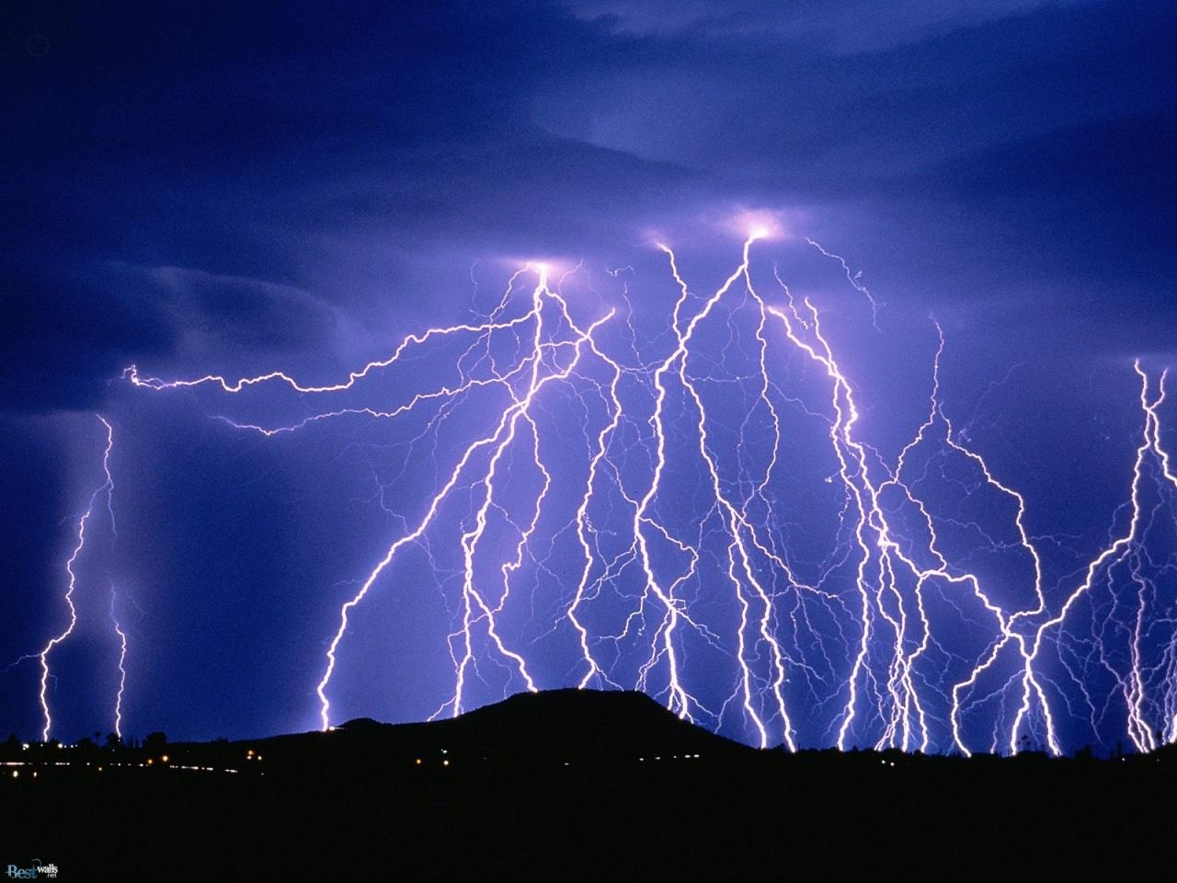

Slide 4
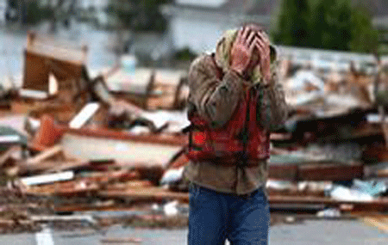
Know your storm…
It destroys…
It displaces…
It disrupts…

Slide 5
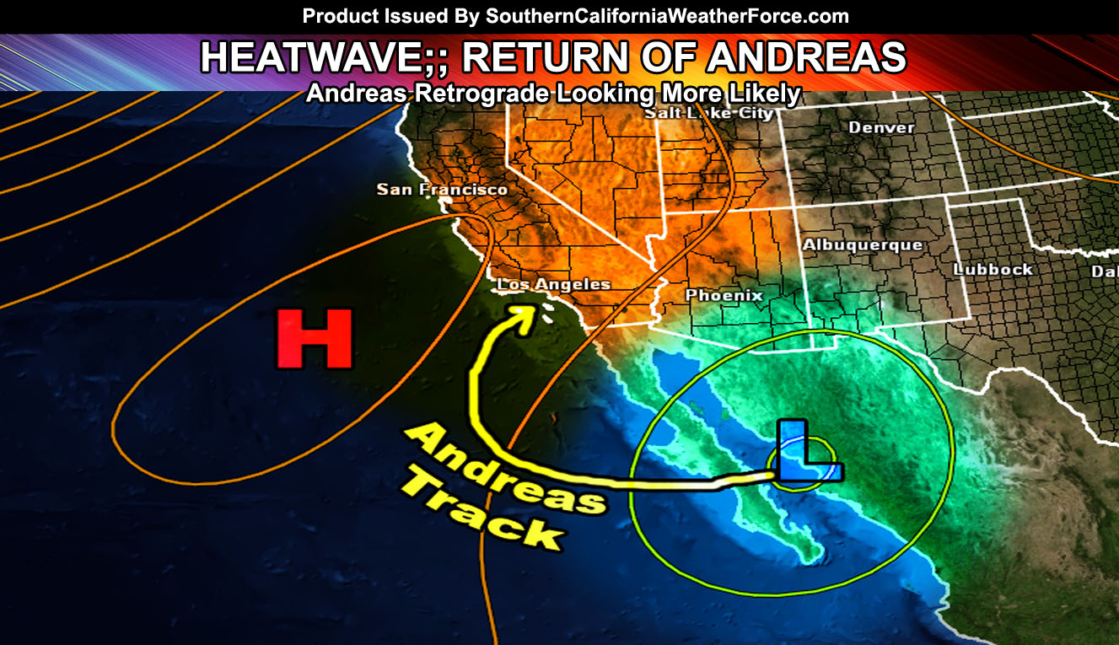
Know your storm…
heat wave vs. cold wave…
high pressure vs. low pressure…
positive vs. negative charge…

Slide 6
Storm of life…
bring about confusion…
bring about fears…
spread doubt…
intimidating…
Inflict pain…

Slide 7
Storm of life…
…any point in your life you are either
…coming out of a storm,
…you are entering into a storm, or
…you're in the middle of the storm.

Slide 8
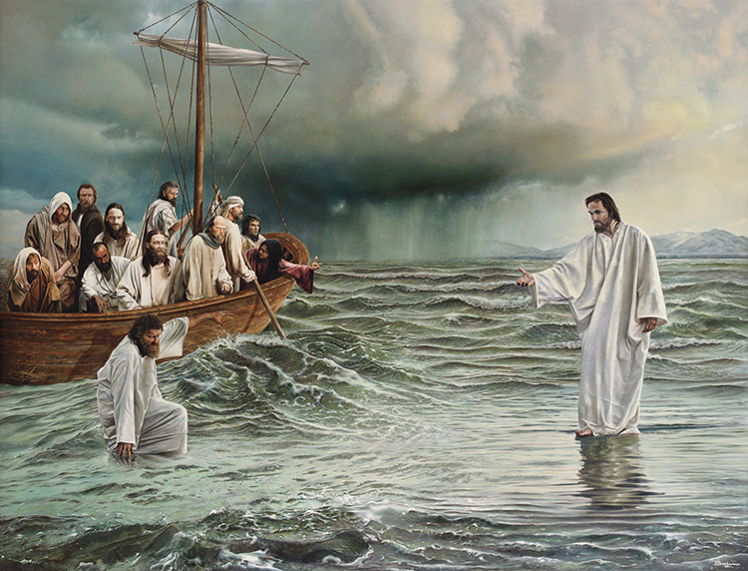

Slide 9
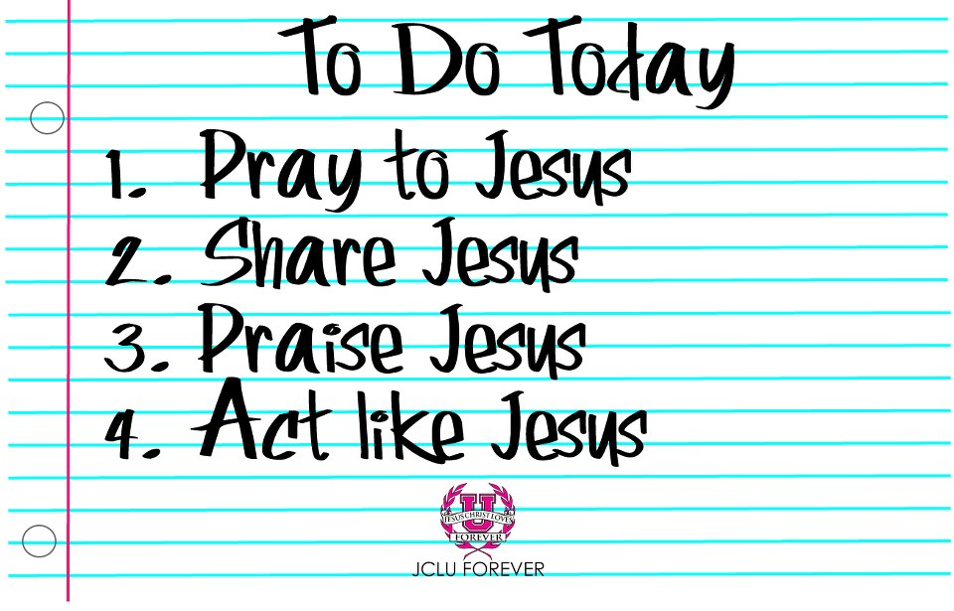
See Jesus in your storm…
…..Bring Jesus back to your senses
…See Jesus
…Hear Jesus
…Speak Jesus
… Feel Jesus
…Touch Jesus

Slide 10
7 Lessons to survive the storm:
Lesson no. 1 :
Storms are often encountered in obedience to Jesus
the holiest path is not always the smoothest path
God leads us into storms by divine appointment
God has a purpose for you in the midst of storm

Slide 11
7 Lessons to survive the storm:
Lesson no. 2 :
The storms should remind us of the promises of God
in verse 22, "Jesus made the disciples get into the boat and to go before him to the other side,“
John and Peter are in the boat
Hebrew 13..never will I leave you nor forsake you

Slide 12
7 Lessons to survive the storm:
Lesson no. 3 :
Even when we cannot see Jesus, Jesus sees us
it is more important that God see us than that we see God

Slide 13
7 Lessons to survive the storm:
Lesson no. 4 :
Jesus comes to us
in verse 25, "And in the fourth watch of the night he came to them, walking on the sea.“
when the situation is most hopeless, it is then that Jesus comes, in the moment of our desperation.

Slide 14
7 Lessons to survive the storm:
Lesson no. 5 :
Our fears might be Jesus in disguise
Verse 26, "But when the disciples saw him walking on the sea, they were terrified. They said, 'It is a ghost!' and they cried out in fear.
But Jesus calmed them, saying, 'Take heart; it is I. Do not be afraid.'

Slide 15
7 Lessons to survive the storm:
Lesson no. 6 :
The water that threatens to be over our head is under Jesus Christ's feet
He has your storm under control
Story of Cruise’s Captain advise before passing the storm
God has the storm in mind when He places you in that boat
Jesus is a better Savior than you are a sinner

Slide 16
7 Lessons to survive the storm:
Lesson no. 7 :
Our ability to walk is dependent on the focus of our eyes
Verse 28, "And Peter answered him, 'Lord, if it is you, command me to come to you on the water.' Jesus said, 'Come.' So Peter got out of the boat and walked on the water and came to Jesus.“
"But," then the Bible says, "when he saw the wind, he was afraid, and beginning to sink he cried out."

Slide 17
Remember…
He sees you and He loves you
Hang on to His promises
He will never leave you nor forsake you
Cast your cares upon Him for He cares for you
Peace I gave to you…let not your heart be troubled
Focus your senses to Jesus
His promises ignite our Faith, Our Faith will empower our Obedience and in His obedience, we will be able to find true Joy in our suffering

